Slide 1
Normal Distribution Probabilities Part B

Slide 2
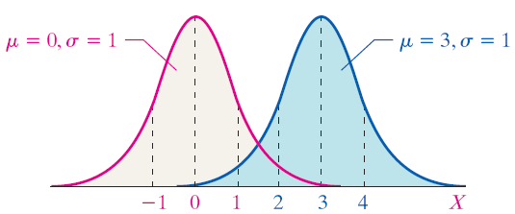
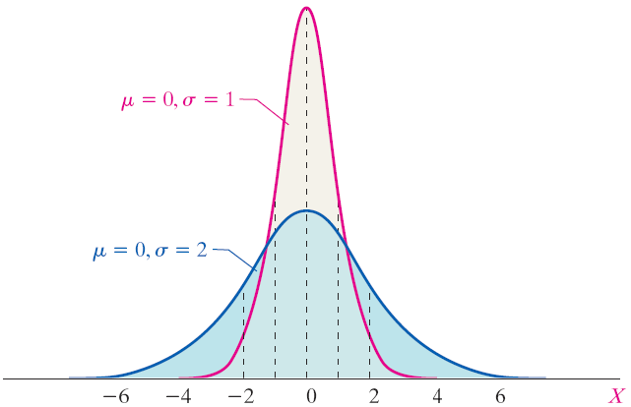

Slide 3

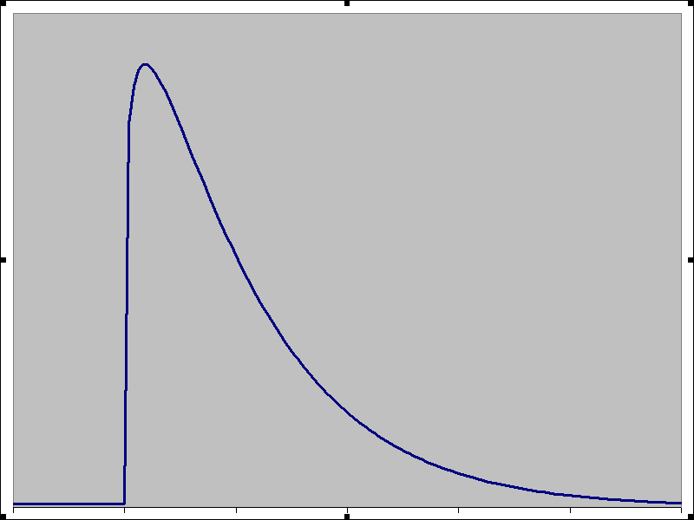
The curve below is not a normal curve because
(a) It is skewed left
(b) It is not continuous
(c) It is skewed right
(d) It has outliers
(e) Not sure

Slide 4
What is the mean of the normal distribution shown?
(a) 120
(b) 20
(c) 140
(d) 100
(e) Not sure

Slide 5
Each graph represents a normal curve with mean μ = 100. Which graph indicates the normal random variable X has more dispersion?
(a) Blue graph
(b) Red graph
(c) Not sure

Slide 6
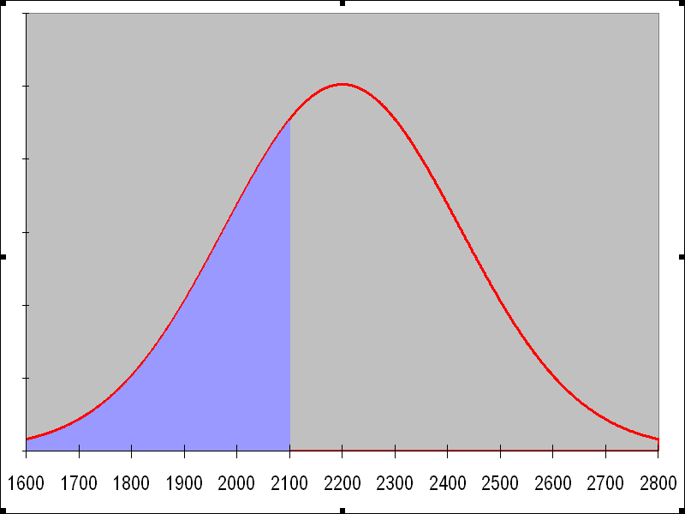
EXAMPLE Interpreting the Area Under a Normal Curve
The weights of giraffes are approximately normally distributed with mean μ = 2200 pounds and standard deviation σ = 200 pounds.
Draw a normal curve with the parameters labeled.
Shade the area under the normal curve to the left of x = 2100 pounds.
Suppose that the area under the normal curve to the left of x = 2100 pounds is 0.3085. Provide two interpretations of this result.
(a), (b)
(c)
The proportion of giraffes whose weight is less than 2100 pounds is 0.3085
The probability that a randomly selected giraffe weighs less than 2100 pounds is 0.3085.

Slide 7
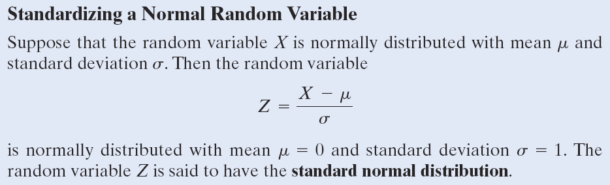

Slide 8
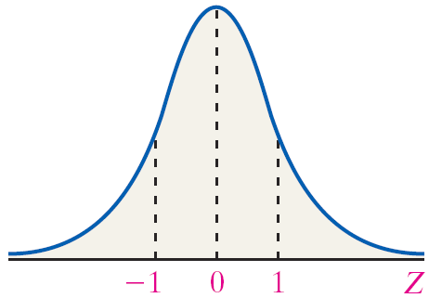

Slide 9
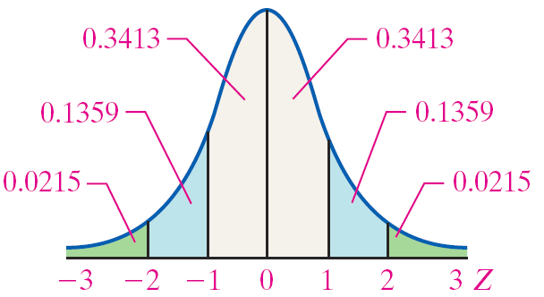

Slide 10
Notation for the Probability of a Standard Normal Random Variable
P(a < Z < b) represents the probability a standard normal random variable is between a and b
P(Z > a) represents the probability a standard normal random variable is greater than a.
P(Z < a) represents the probability a standard normal random variable is less than a.

Slide 11
EXAMPLE Finding Probabilities of Standard Normal Random Variables
Find each of the following probabilities:
(a) P(Z < -0.23)
(b) P(Z > 1.93)
(c) P(0.65 < Z < 2.10)
(a) P(Z < -0.23) = 0.4090
(b) P(Z > 1.93) = 0.0268
(c) P(0.65 < Z < 2.10) = 0.2399

Slide 12
Notation
X – possible value $μ −$mean $σ^{2} −$variance $σ−$ standard deviation

Slide 13
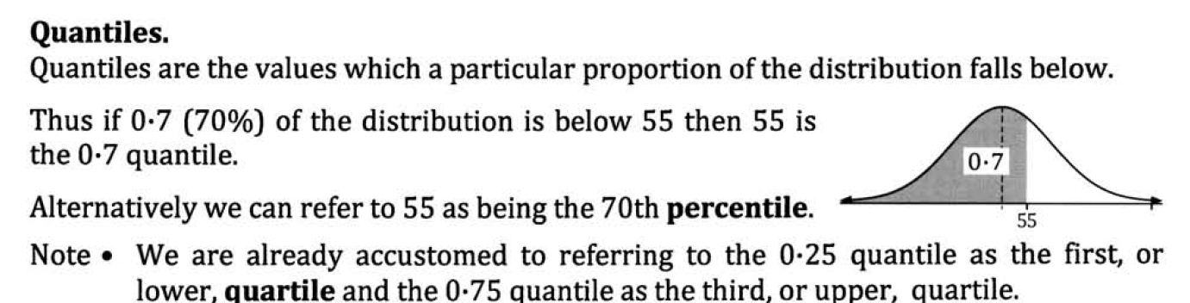
Quantiles/Percentiles
Percentiles divide the distribution into 100 equal parts.

Slide 14
Quantiles/Percentiles
A percentile measures the position of a single data item based on the percentage of data items below that single data item.
Standardized tests taken by larger numbers of students, convert raw scores to a percentile score.
If approximately n percent of the items in a distribution are less than the number x, then x is the nth percentile of the distribution, denoted P_{n}.

Slide 15
Example:
Quantiles/Percentiles
The following are test scores (out of 100) for a particular math class.
44 56 58 62 64 64 70 72 72 72 74 74 75 78 78 79 80 82 82 84 86 87 88 90 92 95 96 96 98 100
Find the fortieth percentile.
40% = 0.4
The average of the 12th and 13th items represents the 40th percentile (P₄₀).
= 0.4(30)
=12
40% of the scores were below 74.5.
So 74.5 is the 40th Percentile

Slide 16
Other Percentiles: Quartiles
Quartiles are the three values (Q₁, Q₂, Q₃) that divide the data set into four (approximately) equal parts.
25%, 50%, and 75%
Quartiles divide a distribution into four equal parts.

Slide 17
Example: Quartiles
Other Percentiles: Quartiles
The following are test scores (out of 100) for a particular math class.
44 56 58 62 64 64 70 72 72 72 74 74 75 78 78 79 80 82 82 84 86 87 88 90 92 95 96 96 98 100
Find the three quartiles.
Q₁= 25%
The 8th item represents the 1st quartile (Q₁)
25% = 0.25
= 0.25(30)
25% of the scores were below 72.
So 72 is the 1st Quartile.
= 7.5

Slide 18
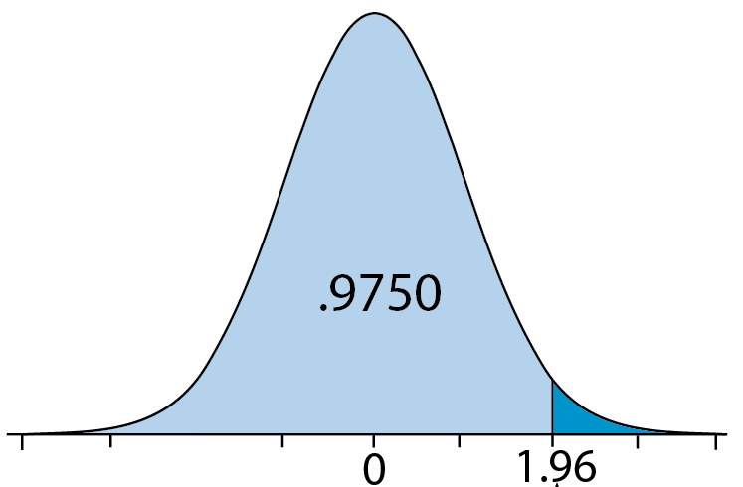
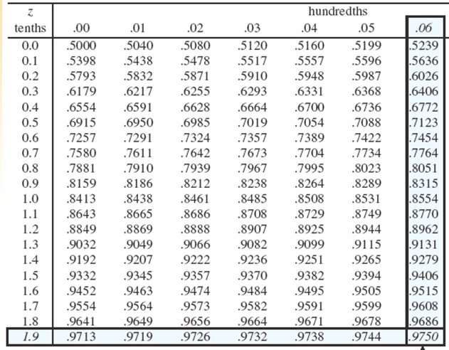
e.g., What is the 97.5th percentile on the Standard Normal curve?
P(X<k) = 0.975
k = 1.96

